Slide 1
The Pumping Lemma for
Context-Free Languages

Slide 2
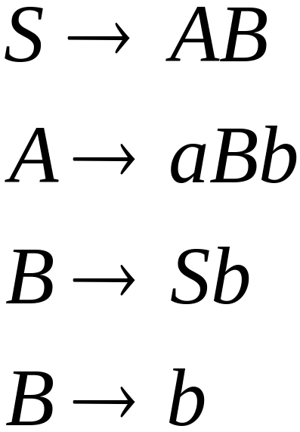
Take an infinite context-free language
Generates an infinite number
of different strings
Example:

Slide 3

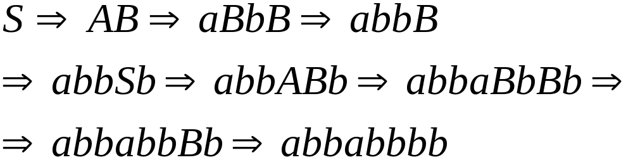
In a derivation of a long string,
variables are repeated
A derivation:

Slide 4


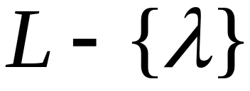

Consider now an infinite
context-free language
Let be the grammar of
Take so that I has no unit-productions
no -productions

Slide 5

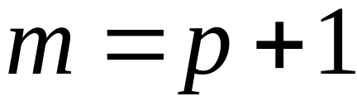

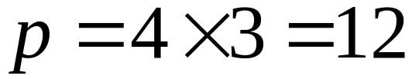
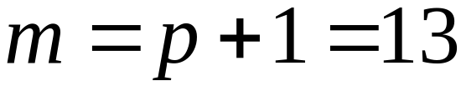
Let
=
(Number of productions) x
(Largest right side of a production)
Let
Example :

Slide 6

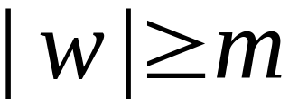

Take a string
with length
We will show:
in the derivation of
a variable of is repeated

Slide 7
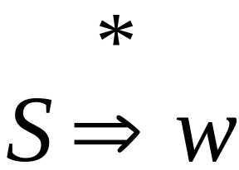
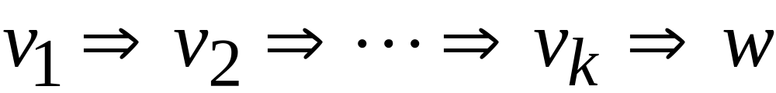
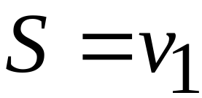

Slide 8
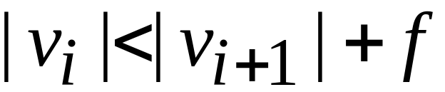
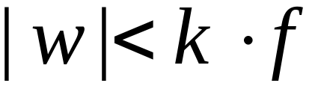
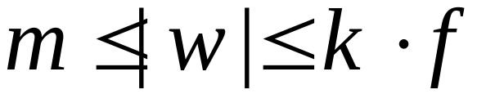
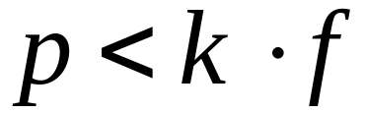
maximum right hand side
of any production

Slide 9
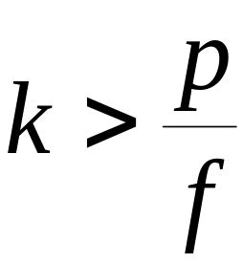
Number of productions
in grammar

Slide 10

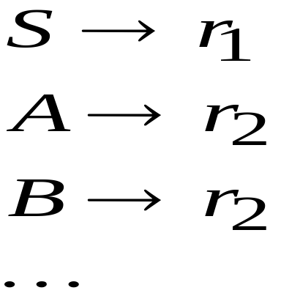
Number of productions
in grammar
Some production must be repeated
Repeated
variable

Slide 11
Derivation of string
Some variable is repeated

Slide 12









Derivation tree of string
Last repeated variable
repeated
Strings of terminals

Slide 13
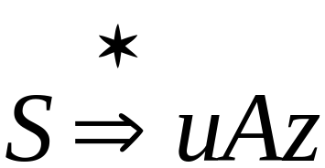
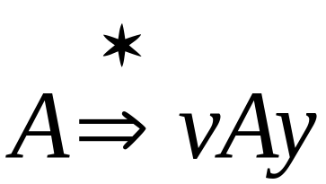
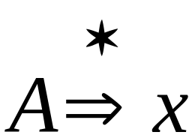
Possible
derivations:

Slide 14
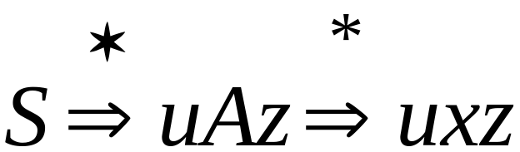
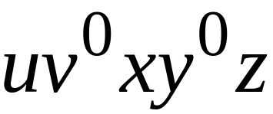
We know:
This string is also generated:

Slide 15
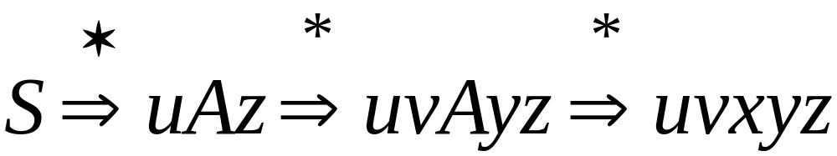
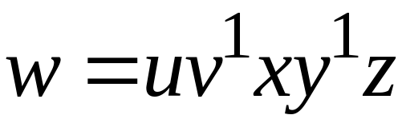
We know:
This string is also generated:
The original

Slide 16
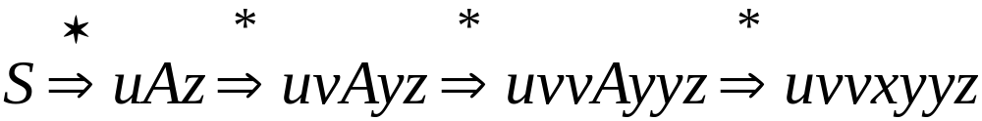
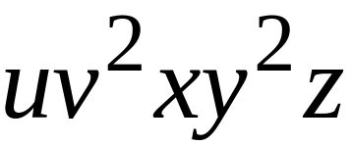
We know:
This string is also generated:

Slide 17
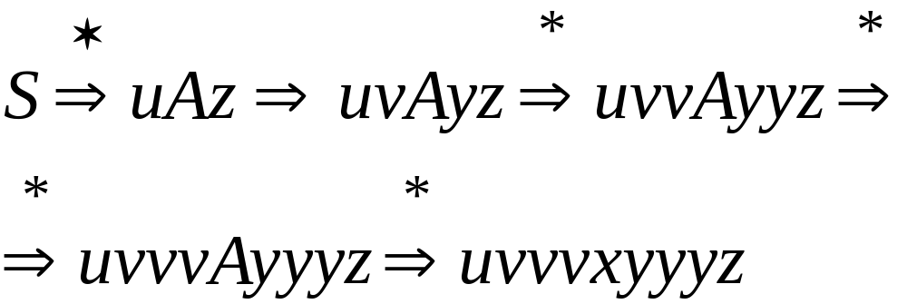
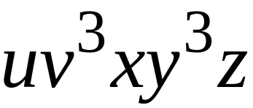
We know:
This string is also generated:

Slide 18

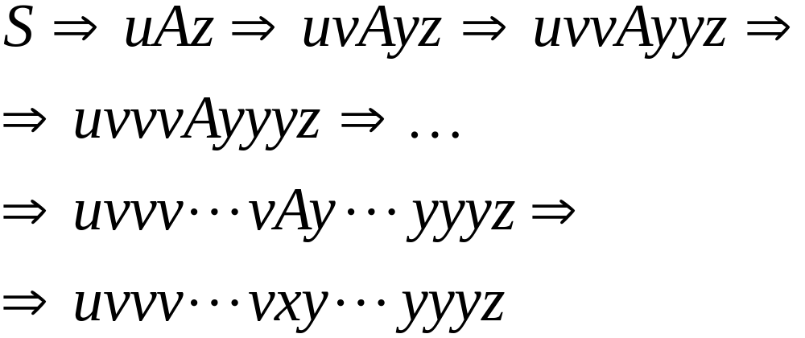
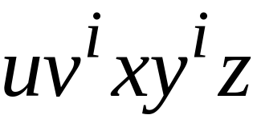
We know:
This string is also generated:

Slide 19

Therefore, any string of the form
is generated by the grammar

Slide 20
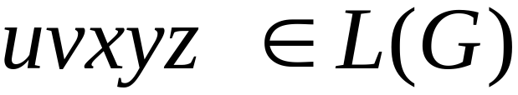
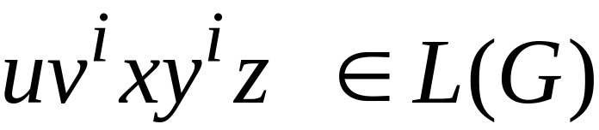

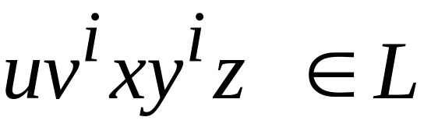
Therefore,
knowing that
we also know that

Slide 21
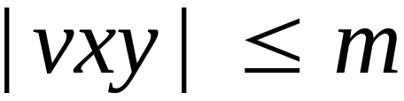

Observation:
Since is the last repeated variable

Slide 22
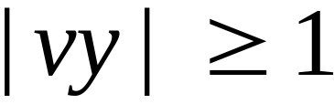

Observation:
Since there are no unit or -productions

Slide 23


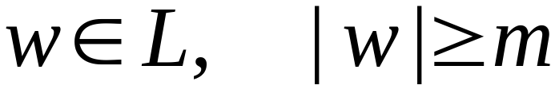
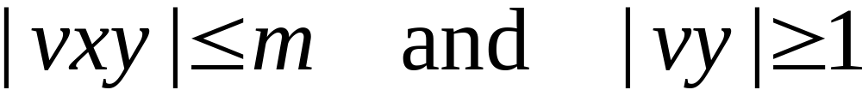
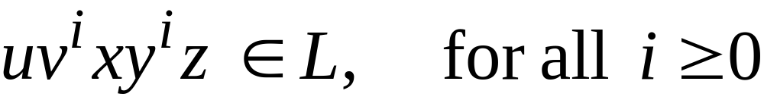
The Pumping Lemma:
For infinite context-free language
there exists an integer such that
for any string
we can write
with lengths
and it must be:

Slide 24
Applications of
The Pumping Lemma

Slide 25
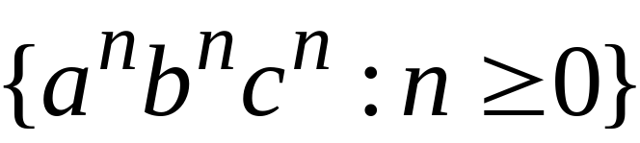

Non-context free languages
Context-free languages

Slide 26
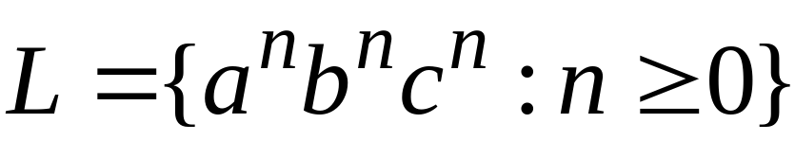
Theorem:
The language
is not context free
Proof:
Use the Pumping Lemma
for context-free languages

Slide 27
Assume for contradiction that
is context-free
Since is context-free and infinite
we can apply the pumping lemma

Slide 28

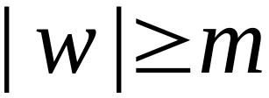
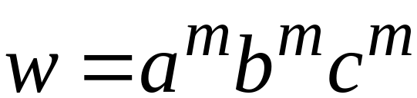
Pumping Lemma gives a magic number
such that:
Pick any string with length
We pick:

Slide 29
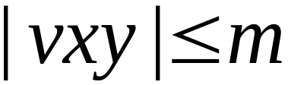
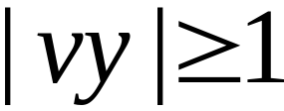
We can write:
with lengths and

Slide 30
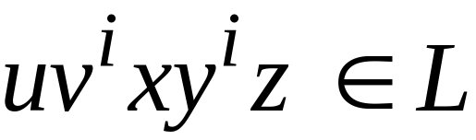
Pumping Lemma says:
for all

Slide 31


We examine all the possible locations
of string in

Slide 32
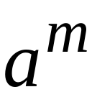


Case 1:
is within

Slide 33



Case 1:
and consist from only

Slide 34


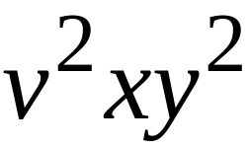
Case 1:
Repeating and

Slide 35
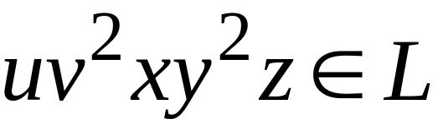
Case 1:
From Pumping Lemma:

Slide 36
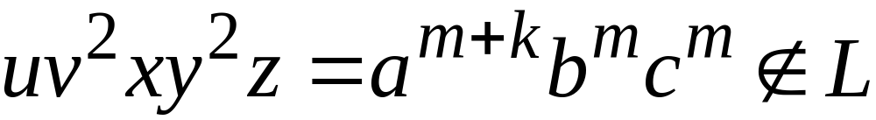
Case 1:
From Pumping Lemma:
However:
Contradiction!!!

Slide 37
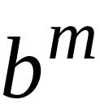
Case 2:
is within

Slide 38
Case 2:
Similar analysis with case 1

Slide 39
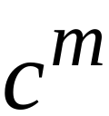
Case 3:
is within

Slide 40
Case 3:
Similar analysis with case 1

Slide 41
Case 4:
overlaps and

Slide 42

Case 4:
Possibility 1:
contains only
contains only

Slide 43



Case 4:
Possibility 1:
contains only
contains only

Slide 44
Case 4:
From Pumping Lemma:

Slide 45

Case 4:
From Pumping Lemma:
However:
Contradiction!!!

Slide 46
Case 4:
Possibility 2:
contains and
contains only

Slide 47




Case 4:
Possibility 2:
contains and
contains only

Slide 48
Case 4:
From Pumping Lemma:

Slide 49

Case 4:
From Pumping Lemma:
However:
Contradiction!!!

Slide 50
Case 4:
Possibility 3:
contains only
contains and

Slide 51
Case 4:
Possibility 3:
contains only
contains and
Similar analysis with Possibility 2

Slide 52


Case 5:
overlaps and

Slide 53
Case 5:
Similar analysis with case 4

Slide 54

There are no other cases to consider
(since , string cannot
overlap , and at the same time)

Slide 55
In all cases we obtained a contradiction
Therefore:
The original assumption that
is context-free must be wrong
Conclusion:
is not context-free

